Slide 1
Self-sufficient deployment: using pairED programming to have fun and sell your solutions
Kristin Carr
Kris Fabick

Slide 2
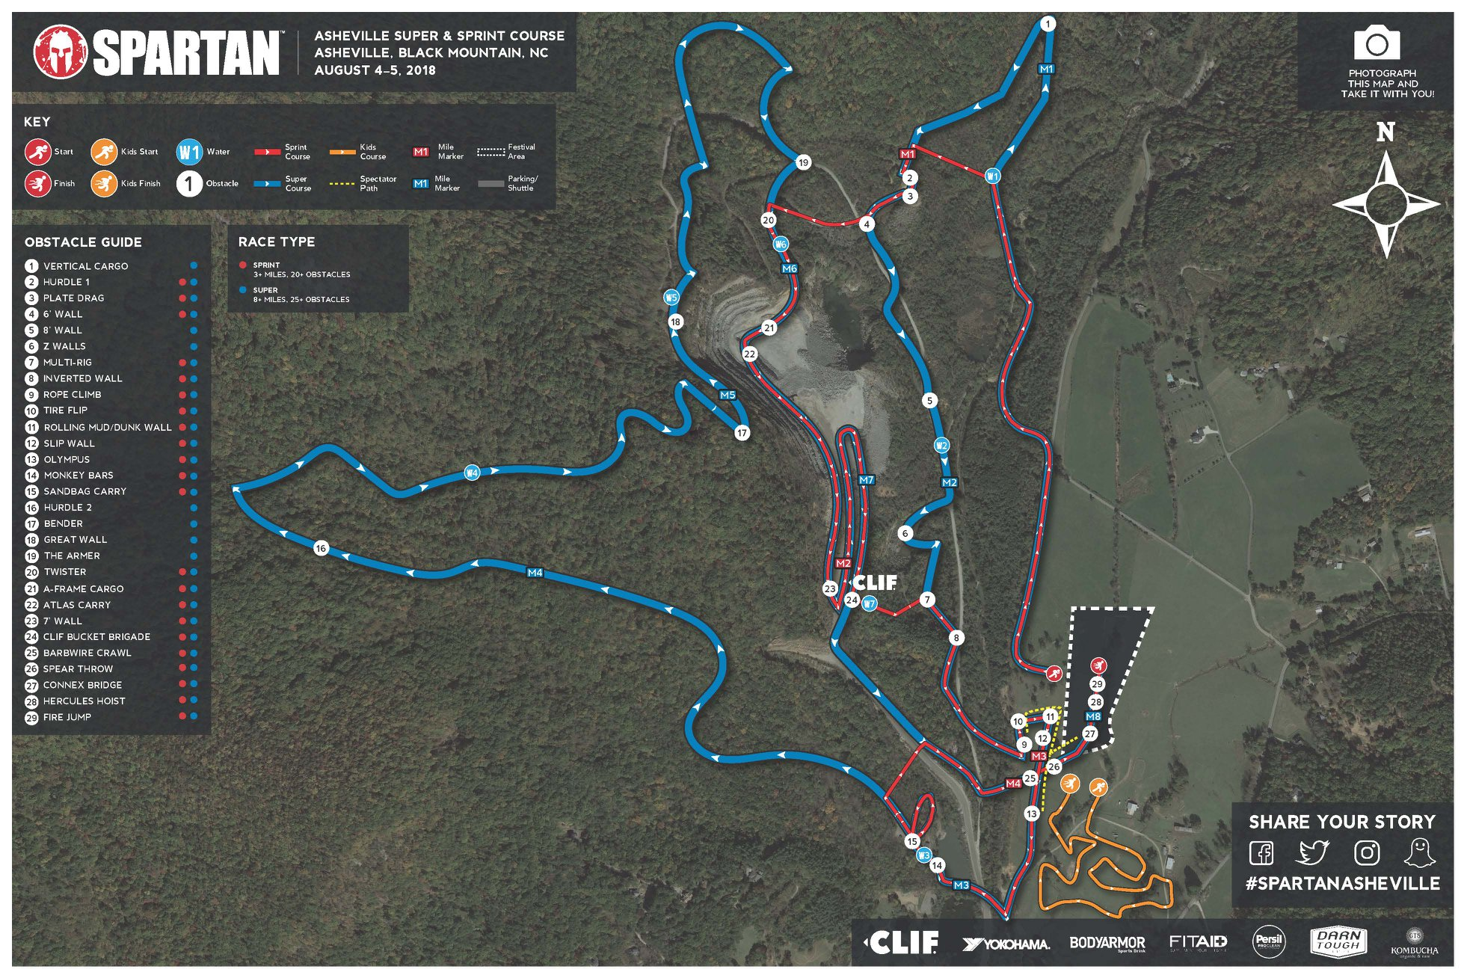
Black Mountain: Stronger Together
25+ obstacles/ 12 miles
Notes:
Picture this: It’s a sunny fall morning and you hear the crunch of the gravel as you pull into a make shift lot at the foothills of an Appalachian Mountain. You walk over to a billboard and there it is, the full course map. 25 + obstacles over 12 miles. There are 7 “mystery obstacles” and 1600 feet of elevation change. This is the start of a Spartan Super and exactly where Kris and I found ourselves, struggling to get wristbands on at the base of Black Mountain.
Though we had trained for an intense physical obstacle course race, we were actually going to get a solid lesson in paired programming. [not needed?: Our deliverable? Complete the course…in under four hours.]
Obstacle course races and data science projects require preparation and adaptability but an overlooked feature is how to handle the difficulty. For the obstacle course race, this came in the form of the mountain ascent itself. Switchback after switchback. As Kris and I are taking in the view and eating up the yellow leaf covered ground we realize that’s not how everyone is seeing it. One racer ahead is crying and wait, those weren’t even fall leaves…they were empty mustard packets other racers were using to prevent cramps.

Slide 3

Black Mountain: Stronger Together
25+ obstacles/ 12 miles
7 "mystery" obstacles

Slide 4
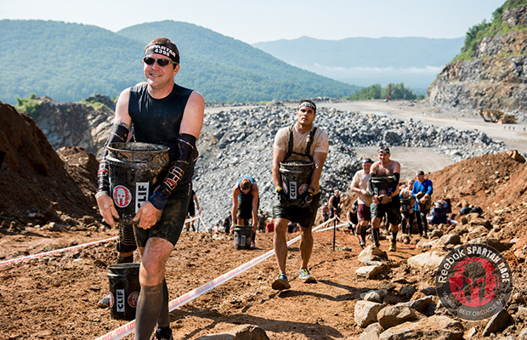
Black Mountain: Stronger Together
25+ obstacles/ 12 miles
7 "mystery" obstacles
1636 feet change in elevation

Slide 5
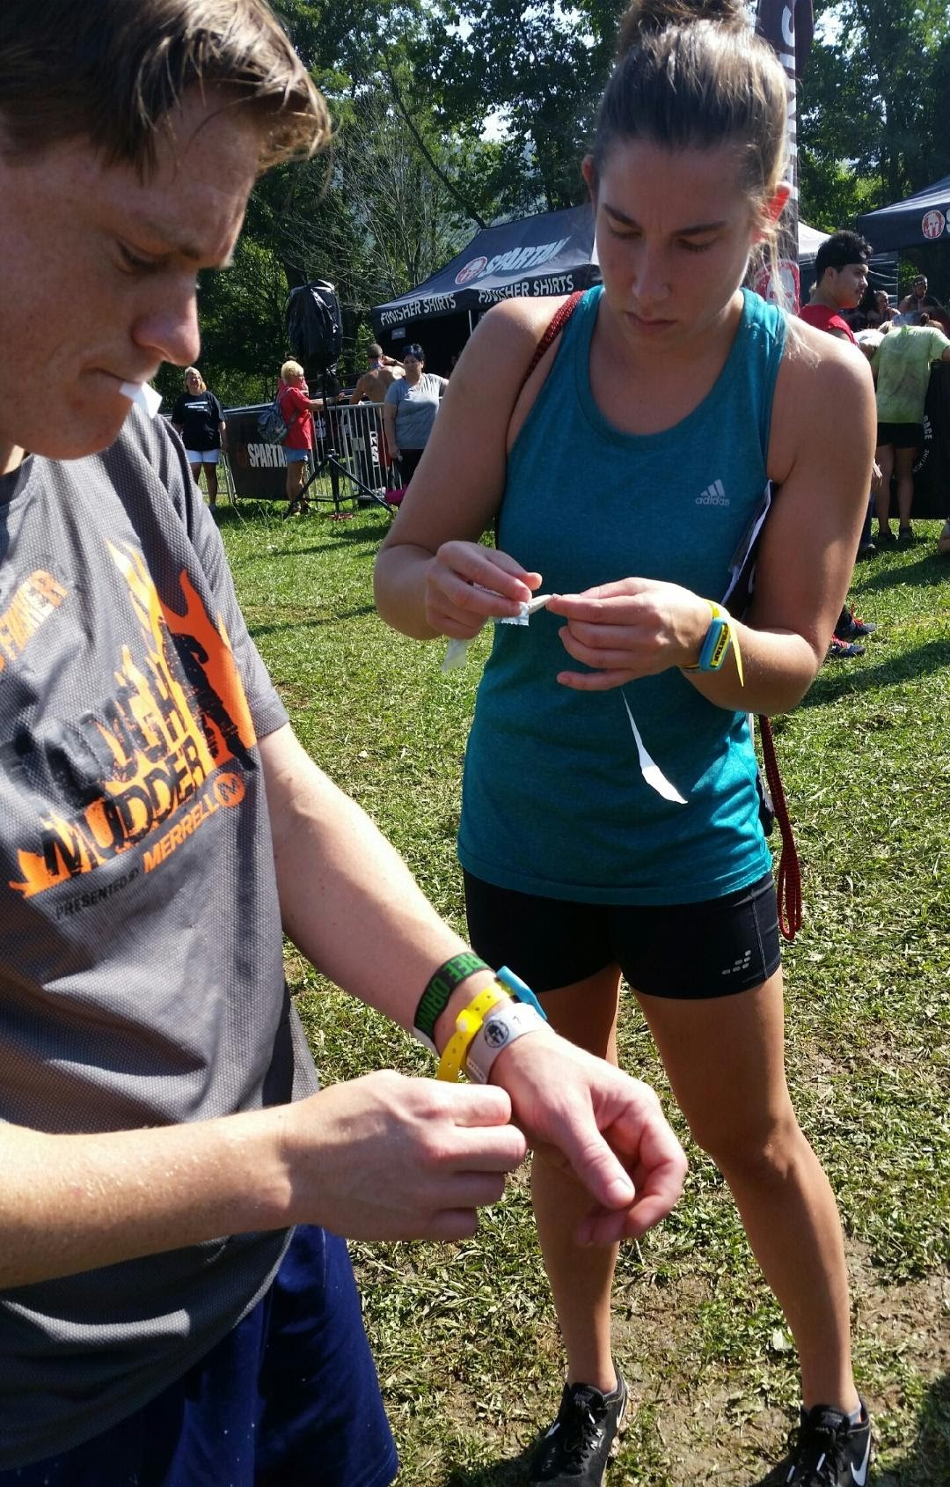
Black Mountain: Stronger Together
25+ obstacles/ 12 miles
7 "mystery" obstacles
1636 feet change in elevation
Preparation
Adaptability
Overcome Difficulty

Slide 6
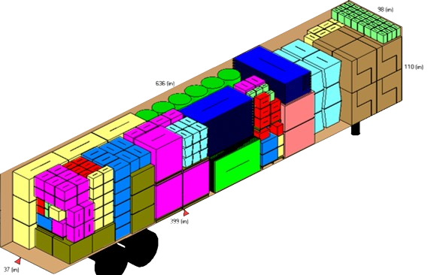

Our Spartan Race at Work
Space occupied / Total space available --> "Container Fill Ratio" (CFR)
Business problem: Predict monthly CFR based on package dimensions
Notes:
KF
We are going to walk you through a case study of a problem we solved at work and how paired programming allowed us to deploy it successfully
Vehicle parts imported in sea freight container
Team-level deployment within a single department

Slide 7
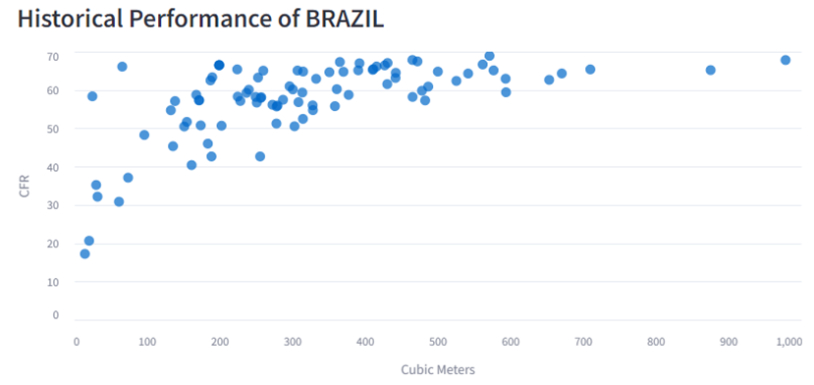

Simple, right?
Notes:
KF
But how do we deploy this thing so someone can (and will) actually use it??
Technical Tooling: Laptop --> team server
Business Requirements: individual support --> team support
The context of the problem isn’t the point here --> the point is, paired programming supports team level deployments

Slide 8
Analytics Deployment Expansion Curve
Reactivity
Dedicated Support
Retain maximum reactivity with sufficient support to ensure stability
Manual /
ad hoc
Local deployment
Team/Dept server deployment
Dept system deployment
Enterprise system deployment
Notes:
KF
Two competing project components: REACTIVITY (go fast!) and SUPPORT (takes time to develop)
Reactivity: the ability to iterate and adjust to changing requests or circumstances
Paired Programming is how we moved from local to team server deployment

Slide 9
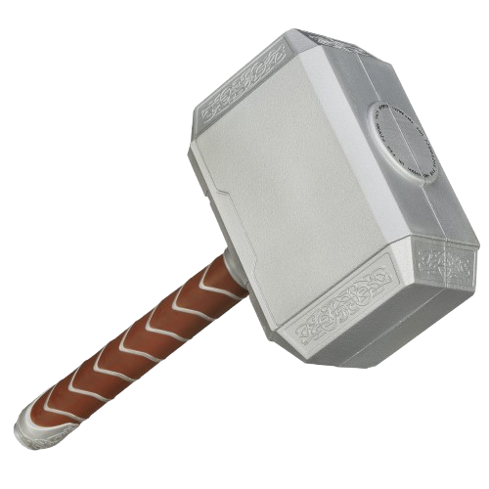
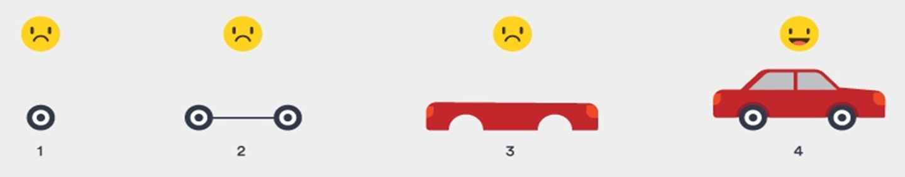
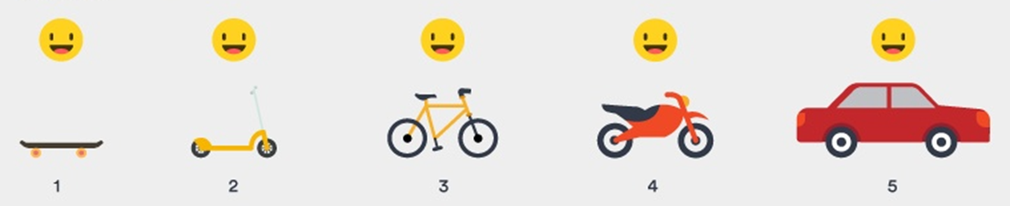
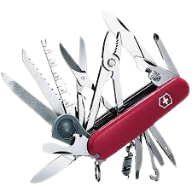
Problem 1: Solutions need to be REACTIVE
Tool we wish we had
ADMIN
Tools we actually have
Notes:
KF
Business team acting as “innovation consultants“
Quick iterations required
No enterprise deployment tools
With less power comes more creativity
Need to deploy incremental solutions before the problem becomes obsolete

Slide 10
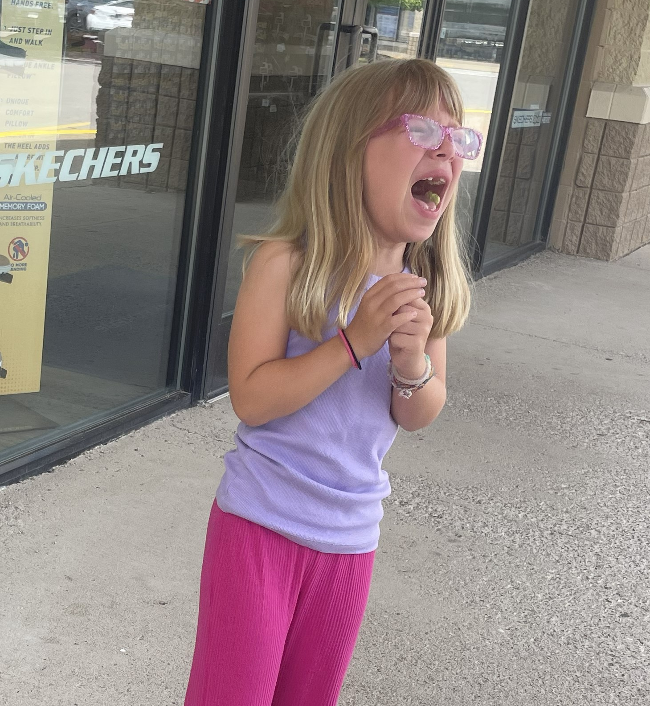


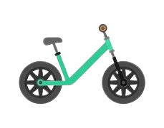
Problem 2: Solutions need to be STABLE
Stability requires sufficient support
(Or else everyone is angry crying)
Notes:
KF
I need to support her until she can support herself and then either one of us could ride the bike
Business requires reliability
NO CALLS ON VACATION!
Redundancy takes time (but its quicker with paired programming!)
Self-sufficient deployment means self-sufficient support (no dedicated support team)
Need sufficient support to maintain stability (or else everyone is angry crying)

Slide 11


Embrace the Paradox: Paired Programming to the Rescue
15% more time with 15% less defects
90% preferred working in pairs
Solo developers passed ~75% of test cases
Paired developers passed ~90% of test cases
REACTIVE
STABLE
https://medium.com/the-liberators/in-depth-the-costs-and-benefits-of-pair-programming-b4b54b27c6ff
Notes:
KC
Paired Programming unlocks REACTIVE and STABLE deployments for team-level projects!
What are we supposed to do when trying to solve a problem requiring two opposing components? Luckily we had just read a medium article released in 2023 discussing the advantages of paired programming.
This type of development achieves more than just stability and reactivity.
The article states that paired programming takes 15% longer, but deliverables have 15% less defects. Though the numbers look the same, these are not equivalent. 15% less defects is orders of magnitude different than 15% more time in development. Less defects creates a more STABLE solution, not to mention all the downstream repercussions that are avoided.
Paired programmers have more fun! After working on a project using paired programming, 90% of users reported it was the preferred method.
Paired programmers create a better solution more often. (is it programmers passed XX% of test cases or XX% of programmers passed the test case?).

Slide 12





The Path to Victory
Develop Model
Pin Model Version
Create API
KF lead
KC lead
Learn together
Call API
Display Model Preds
3 weeks
+
2 weeks
+
1 day
Notes:
KC – more details in the resources slide that will be available to you in the appendix
How did we complete the project and create a deliverable that was not locally hosted? Let me show you
The first component was tidymodels to build the predictive model. Second, we use posit connect as our team/department level deployment location (server?). Remember the graph earlier? This is the place that allows us to have the most reactivity (control) while requiring the least amount of support to be stable.
We used vetiver (a package that works with both R and Python, by the way) to link the locally developed model to our posit connect server. Then we used streamlit to deliver a user-friendly app to the business.
Let me walk you through how we tackled this project.
Kris took the lead. With his expertise in R and statistics he built the model using the tidymodels framework.
I took the lead on the UI. Streamlit was a new tool in our toolbox and I wanted to get some experience with it while coding in python.
We both had recently attended posit conf 2024 where we learned about the capabilities of vetiver when deploying a data science project (better wording here). We both learned how to use vetiver to pin the model (in R) to the Connect server and then create an API that could be called by the streamlit app (in python).

Slide 13
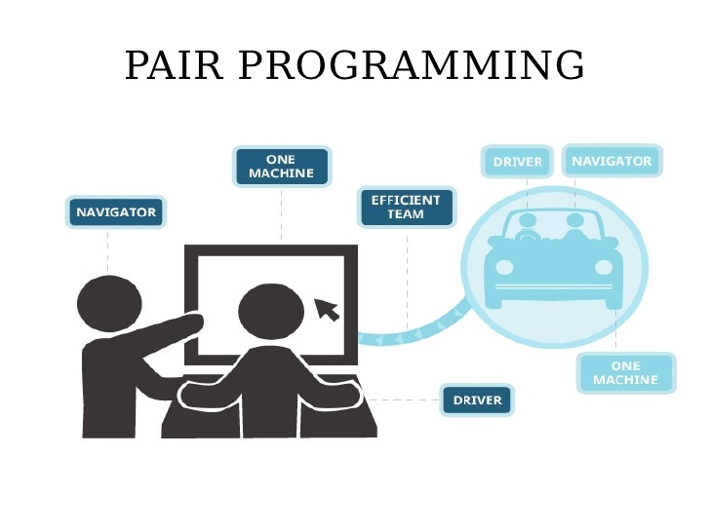
How does paired programming look?
Many approaches
Driver/navigator
Notes:
KF

Slide 14
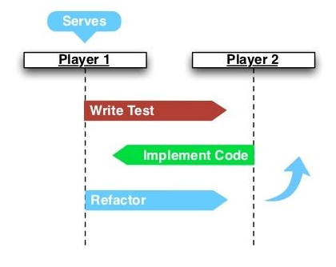
How does paired programming look?
Many approaches
Driver/navigator
Ping/Pong
"Refactoring" is the process of making the code more readable, maintainable, and efficient
Notes:
KF

Slide 15




How does paired programming look?
Many approaches
Driver/navigator
Ping/Pong
Unstructured Synchronous
Exploratory Analysis
Refactor
Model Building
Refactor
UI App Creation
Refactor
"Refactoring" is the process of making the code more readable, maintainable, and efficient
Notes:
KF

Slide 16
How does paired programming look?
Exploratory Analysis
Many approaches
Driver/navigator
Ping/Pong
Unstructured Synchronous
Unstructured Asynchronous ("Pair"allel)
UI App Creation
Model Building
Refactor
Refactor
"Refactoring" is the process of making the code more readable, maintainable, and efficient
Notes:
KF – mention that we did this last technique mostly for this project but have used each technique based on the vibe /needs of the project

Slide 17

How does paired programming NOT look?
Backseat driving
Notes:
KF

Slide 18

How does paired programming NOT look?
Backseat driving
24/7 grind
Notes:
KF

Slide 19

How does paired programming NOT look?
Backseat driving
24/7 grind
Hogging the keyboard
Notes:
KF in "Strong style" paired programming, when you have an idea you actually hand the keyboard to the other programmer so they can code it while you guide

Slide 20

How does paired programming NOT look?
Backseat driving
24/7 grind
Hogging the keyboard
Nap time
Notes:
KF

Slide 21

Lesson #1: “Pairing” is a mindset, not a technique
Follow the vibe
Notes:
KF
There is no prescription; follow the vibe
Simply programming together is not sufficient
by now youre probably thinking, well if I could pair program with my work best friend of course I'd give it a try! but we are here to tell you that friction will find you. And it should. As I tell my daughter often, if you're not failing you're not learning.
Practice patience and humility
Be curious

Slide 22


Lesson #1: “Pairing” is a mindset, not a technique
Follow the vibe
Embrace friction
Notes:
KF
There is no prescription; follow the vibe
Simply programming together is not sufficient
by now youre probably thinking, well if I could pair program with my work best friend of course I'd give it a try! but we are here to tell you that friction will find you. And it should. As I tell my daughter often, if you're not failing you're not learning.
Practice patience and humility
Be curious

Slide 23


Lesson #1: “Pairing” is a mindset, not a technique
Follow the vibe
Embrace friction
Slow down to speed up
Notes:
KF
There is no prescription; follow the vibe
Simply programming together is not sufficient
by now youre probably thinking, well if I could pair program with my work best friend of course I'd give it a try! but we are here to tell you that friction will find you. And it should. As I tell my daughter often, if you're not failing you're not learning.
Practice patience and humility
Be curious

Slide 24
Lesson #2: Know Your Strengths; Adapt for Your Weaknesses
Before Paired Programming
After Paired Programming
Notes:
KC
People with different tools, one with Posit Connect, tidymodels, R, vetiver and posit, one with python and streamlit
(2024) We had just been to posit conf 2024 where we learned about workflows in R/Python. Wedidn’t know exactly how things would go, but we did know we had sufficient tools to pull off a localdeployment AND we had the infrastructure with paired programming to support the solution in thefuture
Use the right tool for the right job
Is my team ready to implement this tool?
Is my customer ready to utilize this tool?

Slide 25


Lesson #3: Create Checkpoints
Refactor often
Notes:
KC
Metaphor: top-roping and clipping into anchors to protect your fall
Top rope, top is readme, show some steps leading up to the top
Avoid losing ground when team members/developers are not available
Generate ownership and pride from developers and business
Code with reproducibility in mind
Teach others to fish
Stay curious
Example: Standardized README published "business publicly" (bitbucket at your business)
Created buy in and alignment from the development team
Goal of readme: include enough business/project/technical background so that anyone with technical experience (but notproject familiarity) could come behind you and reproduce your pipeline/project/deployment without anyadditional supports

Slide 26
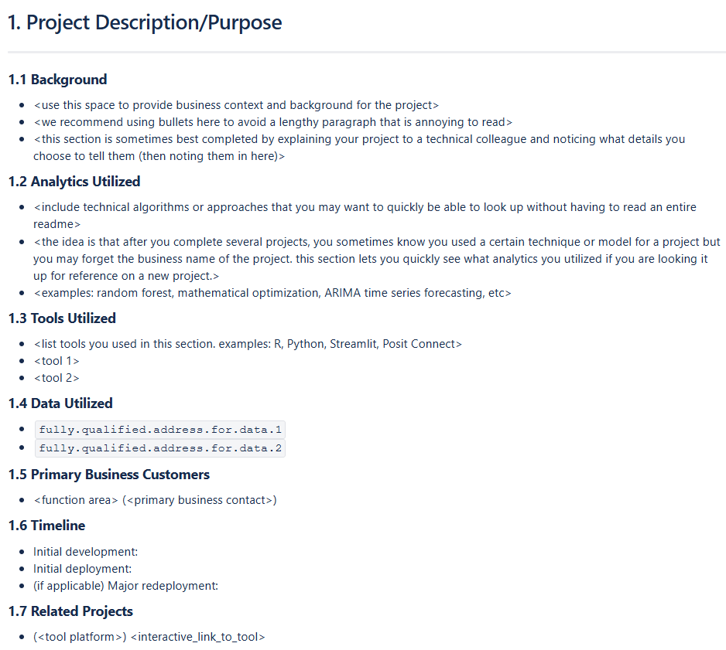
Lesson #3: Create Checkpoints
Refactor often
Implement standards
Notes:
KC
Metaphor: top-roping and clipping into anchors to protect your fall
Top rope, top is readme, show some steps leading up to the top
Avoid losing ground when team members/developers are not available
Generate ownership and pride from developers and business
Code with reproducibility in mind
Teach others to fish
Stay curious
Example: Standardized README published "business publicly" (bitbucket at your business)
Created buy in and alignment from the development team
Goal of readme: include enough business/project/technical background so that anyone with technical experience (but notproject familiarity) could come behind you and reproduce your pipeline/project/deployment without anyadditional supports

Slide 27

Lesson #3: Create Checkpoints
Refactor often
Implement standards
Slow down to speed up (reprise)
If you want to go fast, go alone.
If you want to go far, go together.
Notes:
KC
Metaphor: top-roping and clipping into anchors to protect your fall
Top rope, top is readme, show some steps leading up to the top
Avoid losing ground when team members/developers are not available
Generate ownership and pride from developers and business
Code with reproducibility in mind
Teach others to fish
Stay curious
Example: Standardized README published "business publicly" (bitbucket at your business)
Created buy in and alignment from the development team
Goal of readme: include enough business/project/technical background so that anyone with technical experience (but notproject familiarity) could come behind you and reproduce your pipeline/project/deployment without anyadditional supports

Slide 28

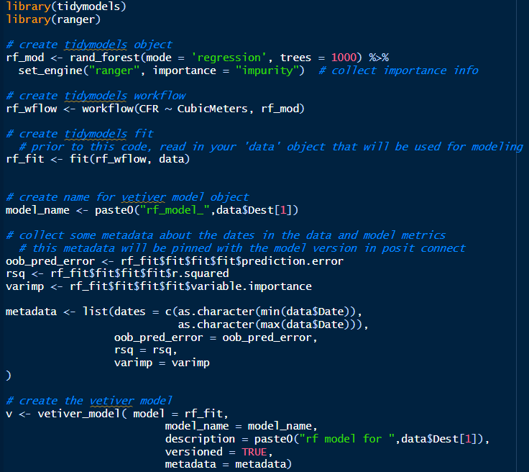
The Technical Details
Develop Model
Configure Posit Connect
Pin Model to Posit Connect
Create Vetiver API
Call Vetiver API
Display Model Predictions
Notes:
KC – more details in the resources slide
Posit Connect is our tool, our server, deployment to our teams

Slide 29
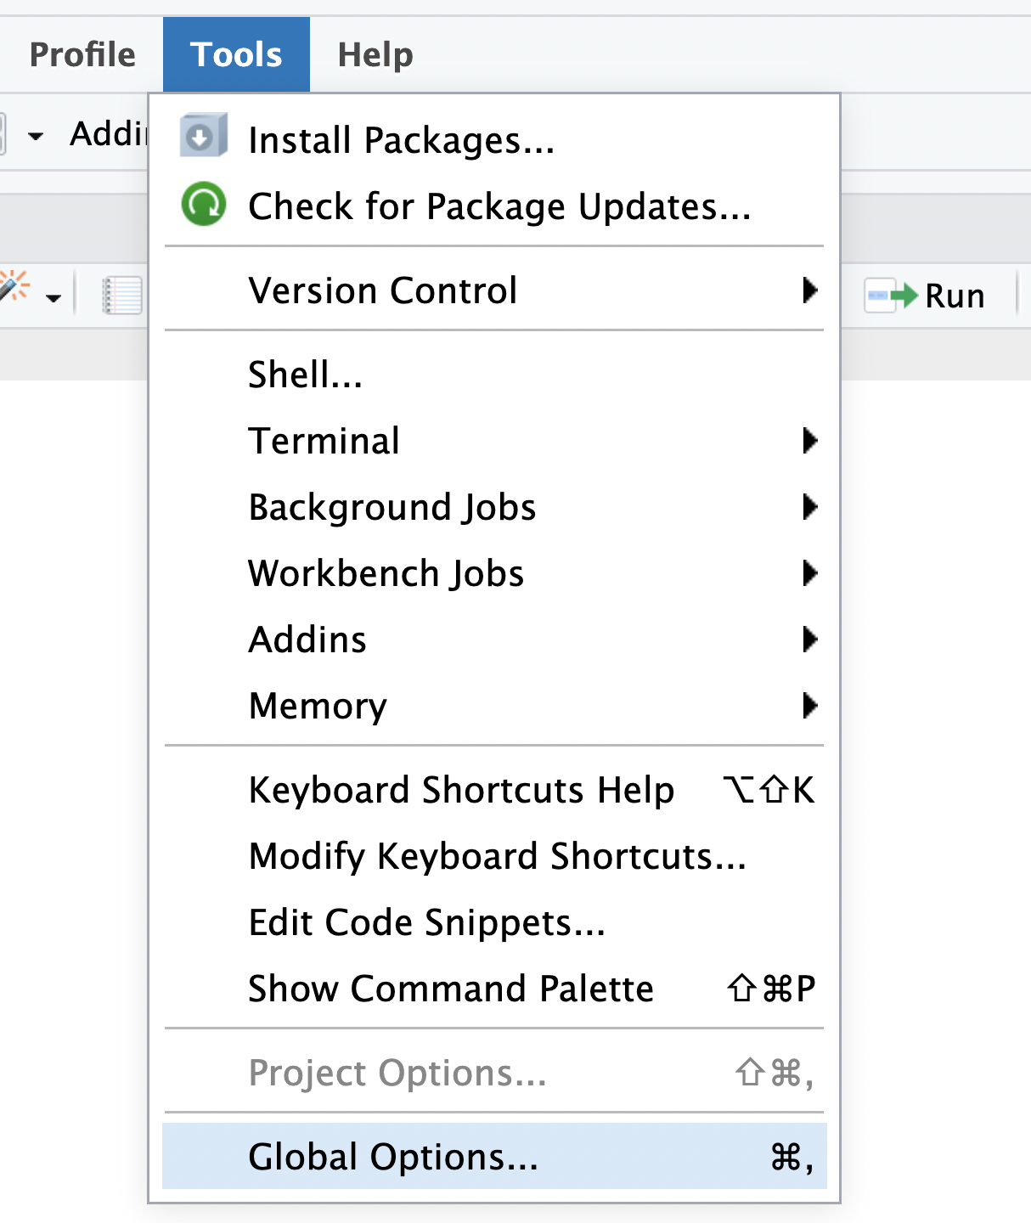
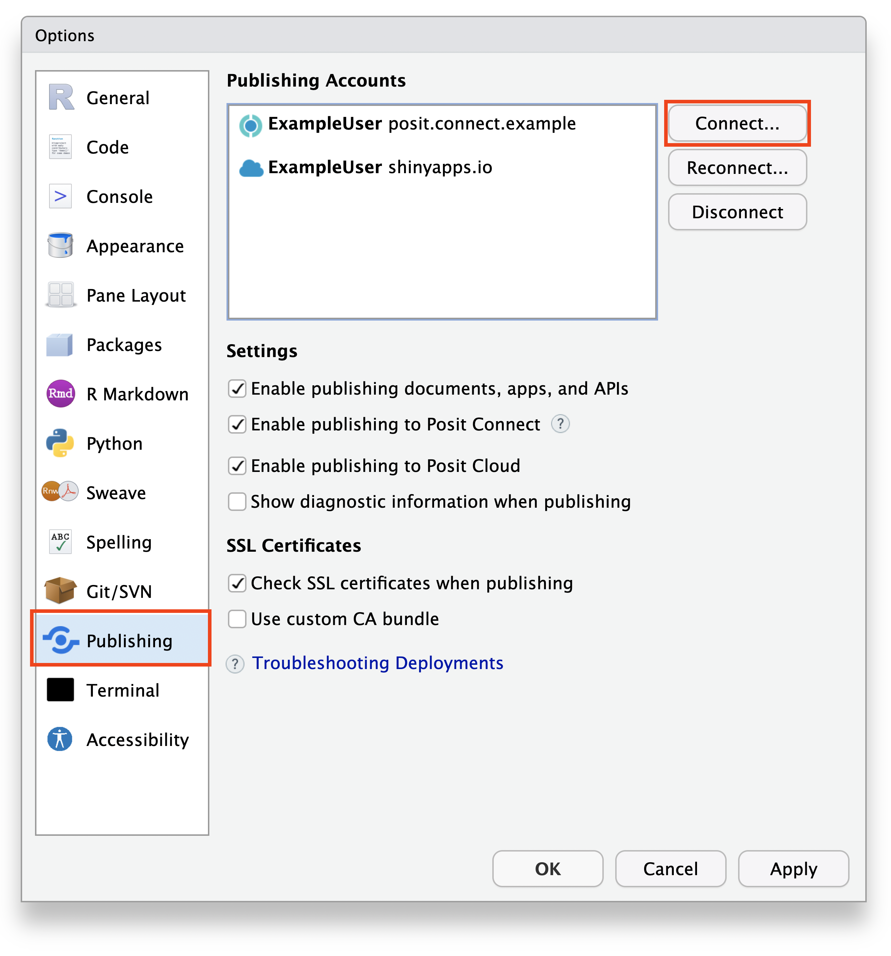
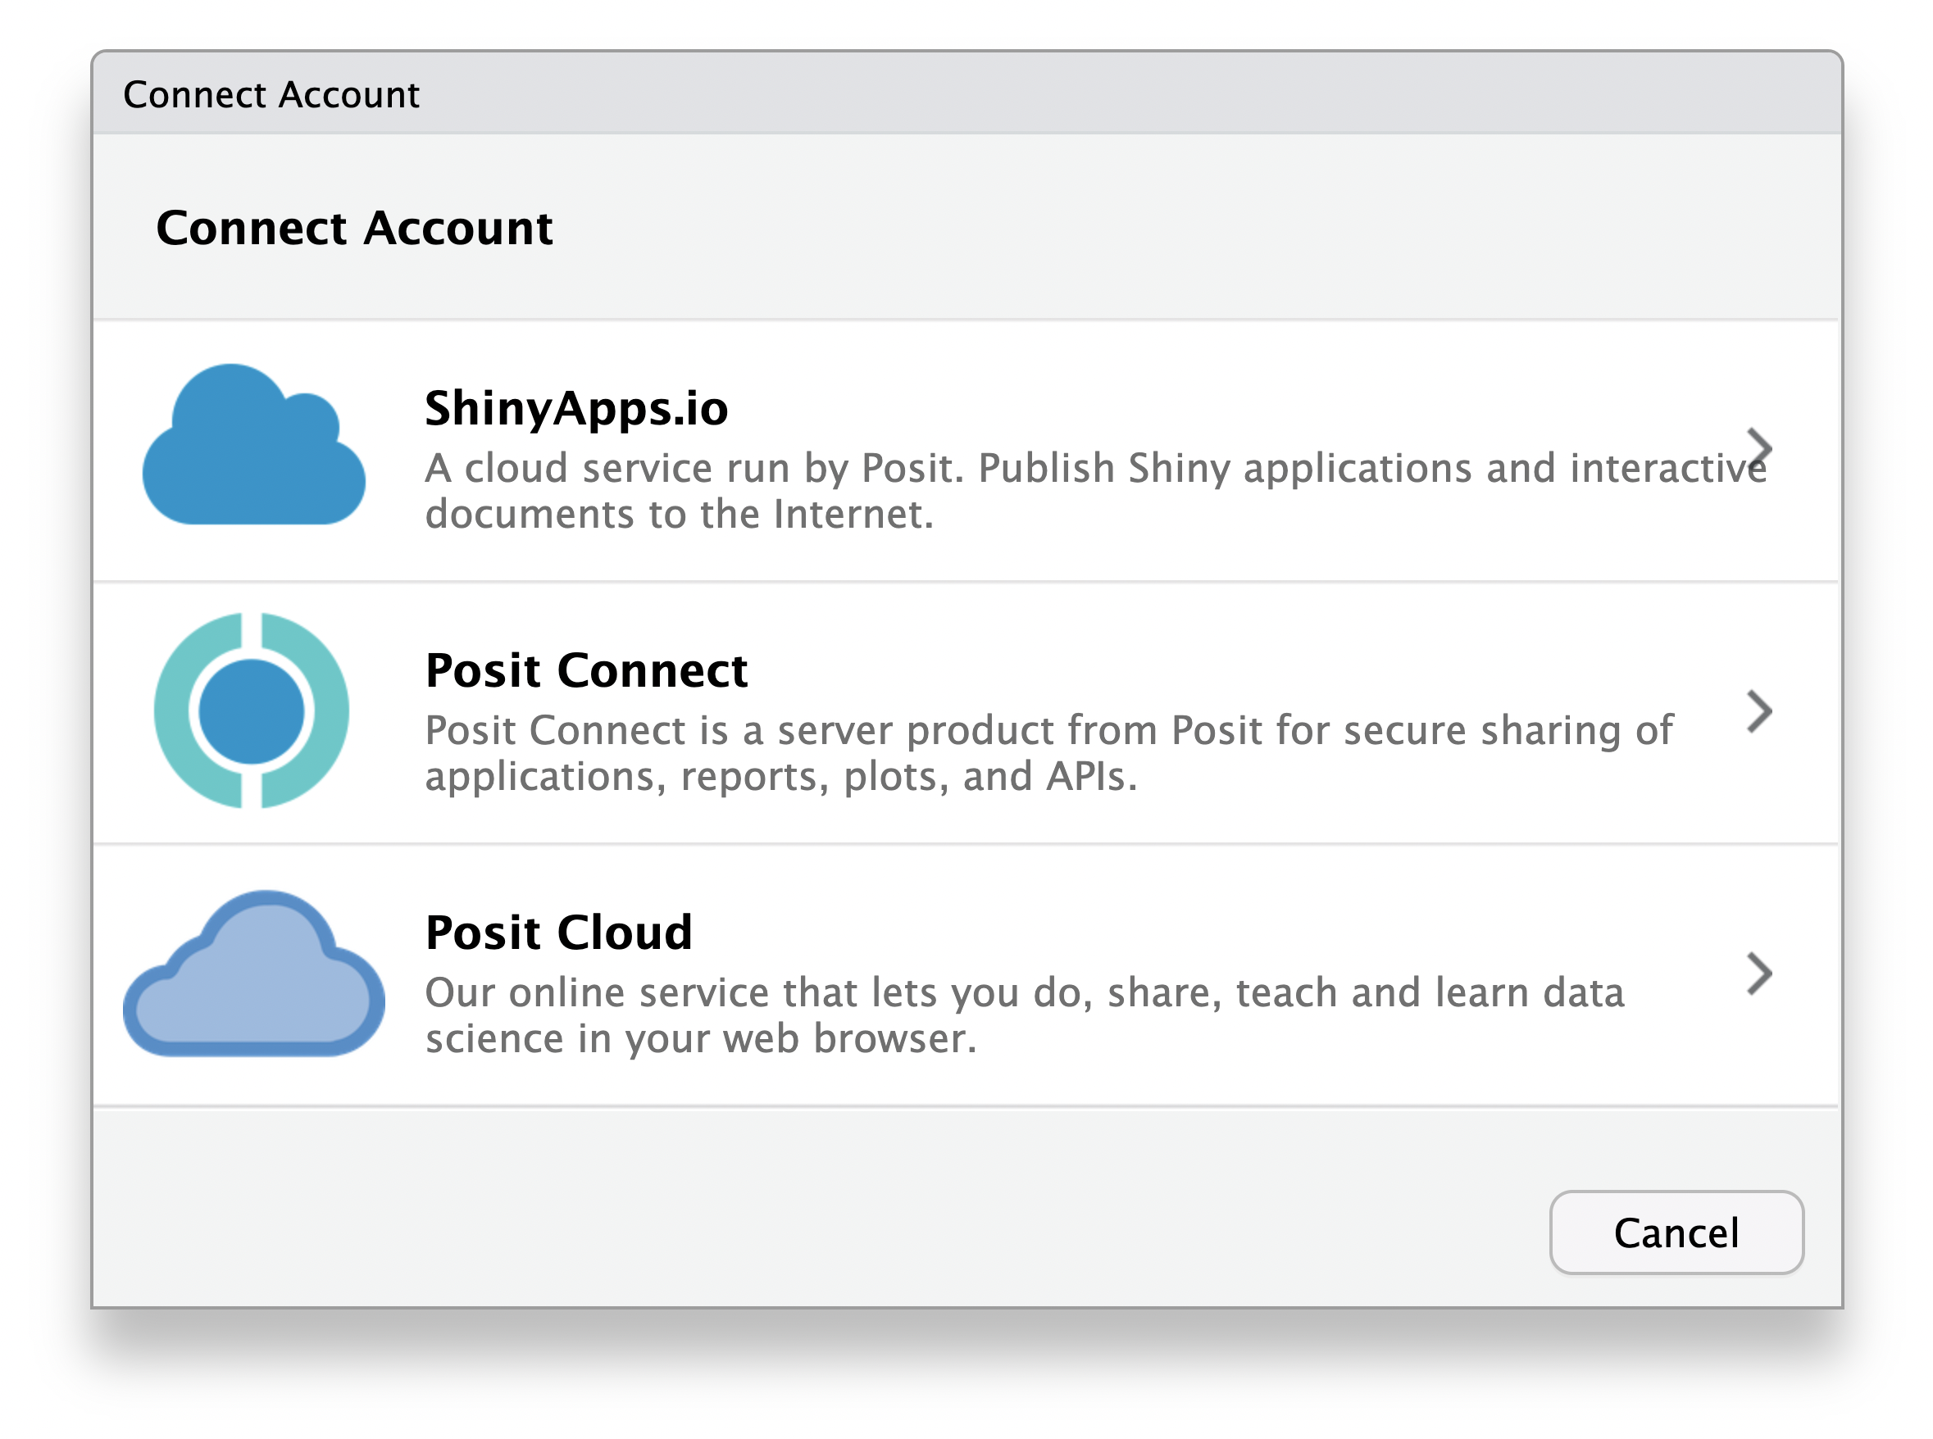
The Technical Details
Develop Model
Configure Posit Connect
Pin Model to Posit Connect
Create Vetiver API
Call Vetiver API
Display Model Predictions
https://docs.posit.co/ide/user/ide/guide/publish/connecting.html
1
2
3
Notes:
KC – more details in the resources slide
Posit Connect is our tool, our server, deployment to our teams

Slide 30
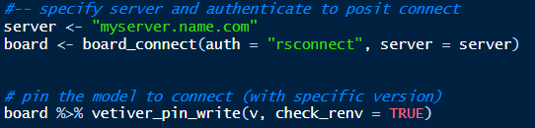
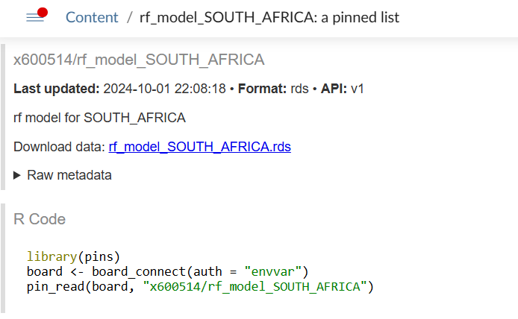
The Technical Details
Develop Model
Configure Posit Connect
Pin Model to Posit Connect
Create Vetiver API
Call Vetiver API
Display Model Predictions
R code to pin the model
Posit Connect view of pinned model
Notice the metadata section
Posit Connect provides the code you need to read the model
Notes:
KC – more details in the resources slide
Posit Connect is our tool, our server, deployment to our teams

Slide 31
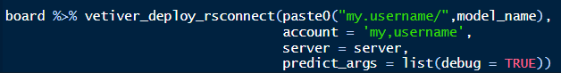
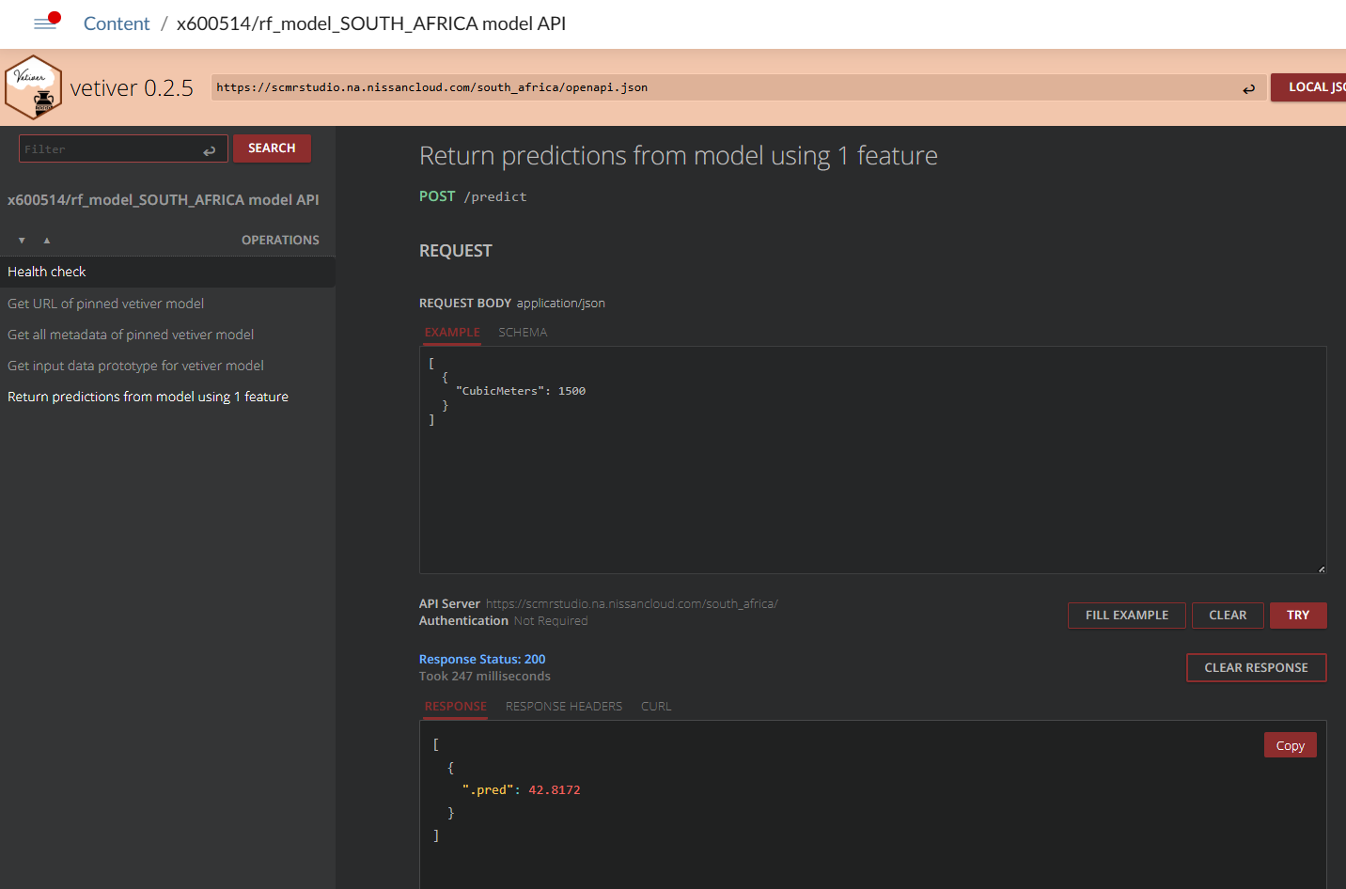
The Technical Details
https://docs.posit.co/connect/user/vetiver/
Develop Model
Configure Posit Connect
Pin Model to Posit Connect
Create Vetiver API
Call Vetiver API
Display Model Predictions
R code to create vetiver API Posit Connect view of API
Vetiver creates endpoints for:
GET /ping
GET /pin-url
GET /metadata
GET /prototype
POST /predict
Notes:
KC – more details in the resources slide
Posit Connect is our tool, our server, deployment to our teams

Slide 32

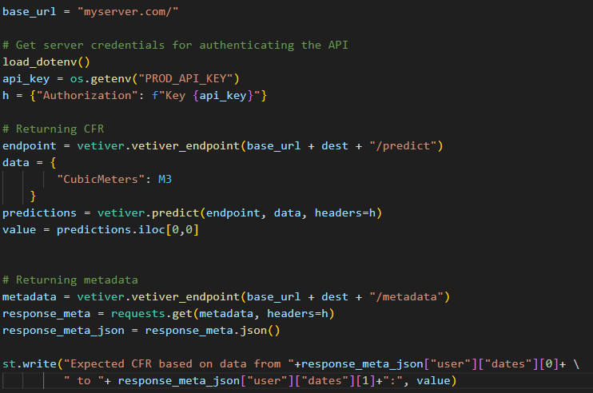
The Technical Details
Develop Model
Configure Posit Connect
Pin Model to Posit Connect
Create Vetiver API
Call Vetiver API
Display Model Predictions
Notes:
KC – more details in the resources slide
Posit Connect is our tool, our server, deployment to our teams

Slide 33
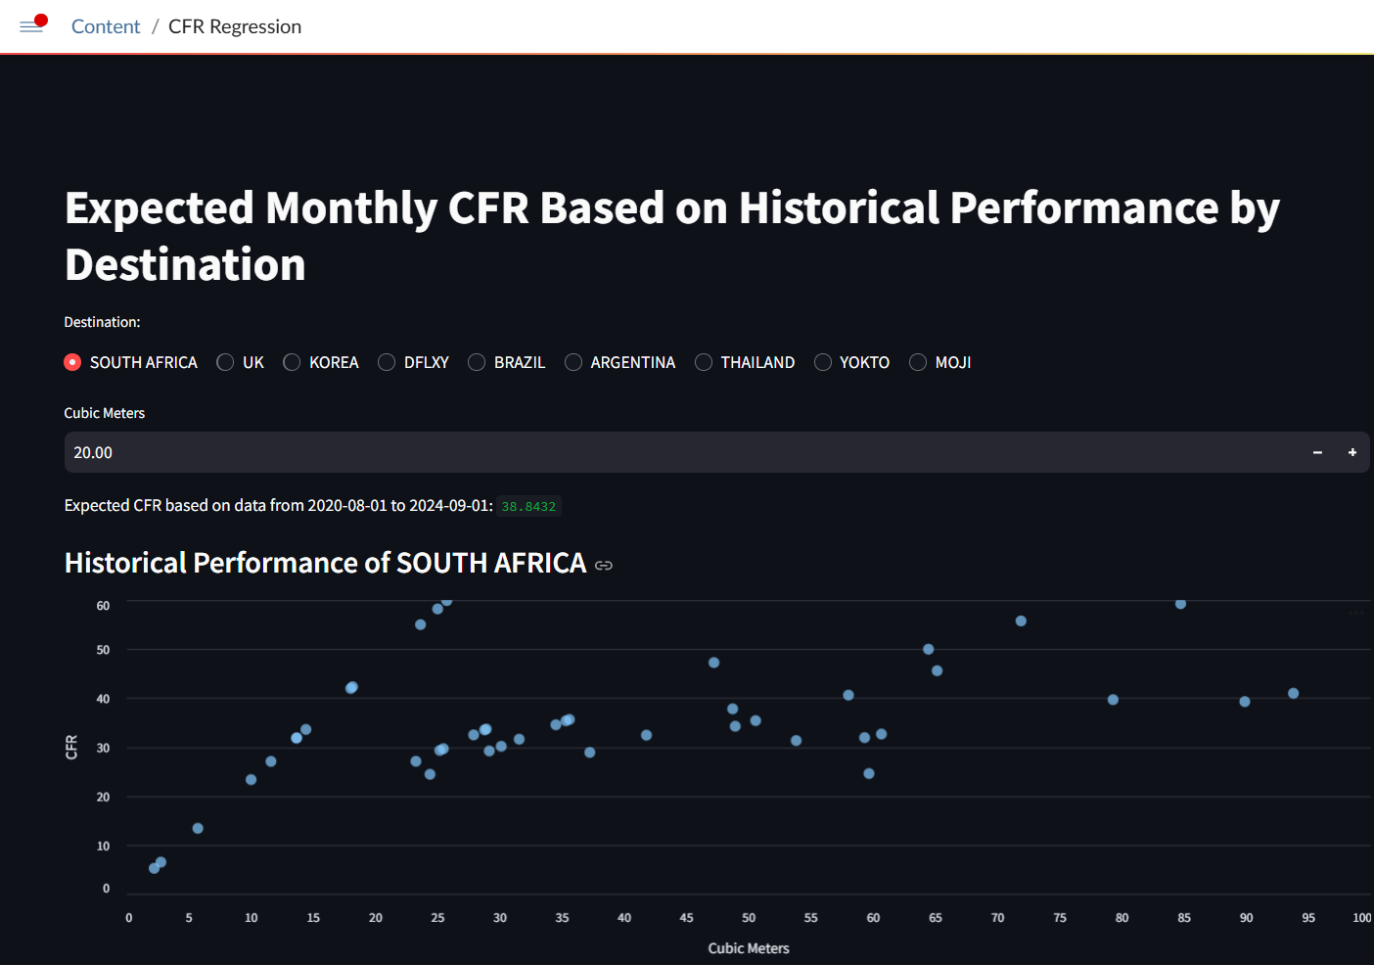
The Technical Details
Develop Model
Configure Posit Connect
Pin Model to Posit Connect
Create Vetiver API
Call Vetiver API
Display Model Predictions
Notes:
KC – more details in the resources slide
Posit Connect is our tool, our server, deployment to our teams

Slide 34


Want to Learn More?

